Slide 1
Semantic Tableau and Resolution Refutation
Lecture Module 12

Slide 2
Semantic Tableaux System in PL
Earlier approaches require
  construction of proof of a formula from given set of formulae and are called direct methods.
In semantic tableaux,
  the set of rules are applied systematically on a formula or set of formulae to establish its validity, consistency or inconsistency.
Semantic tableau
  binary tree constructed by using semantic rules with a formula as a root
Assume α and β be any two formulae.

Slide 3
Semantic Tableaux Rules
Rule 1: A tableau for a formula (α Λ β) is constructed by adding both α and β to the same path (branch). This can be represented as follows: α Λ β
α
β
Rule 2: A tableau for a formula ~ (α Λ β) is constructed by adding two alternative paths one containing ~ α and other containing ~β.
~ (α Λ β)
~ α ~ β
Rule 3: A tableau for a formula (α V β) is constructed by adding two new paths one containing α and other containing β.
α V β
α β
Rule 4: A tableau for a formula ~ (α V β) is constructed by adding both ~ α and ~ β to the same path. This can be expressed as follows: ~ ( α V β)
~ α
~ β

Slide 4
Rules - Cont..
Rule 5: ~ ~ α α
Rule 6: α → β
~ α β
Rule 7: ~ (α → β)
α
~ β
Rule 8: α ↔ β ≅ (α Λ β) V (~ α Λ ~ β)
α ↔ β
α Λ β ~ α Λ ~ β
Rule 9: ~ (α ↔ β) ≅ (α Λ ~ β) V (~ α Λ β)
~ (α ↔ β)
α Λ ~ β ~ α Λ β

Slide 5
Consistency and Inconsistency
If an atom P and ~ P appear on a same path of a semantic tableau,
  then inconsistency is indicated and such path is said to be contradictory or closed (finished) path.
  Even if one path remains non contradictory or unclosed (open), then the formula α at the root of a tableau is consistent.
Contradictory tableau (or finished tableau):
  It defined to be a tableau in which all the paths are contradictory or closed (finished).
If a tableau for a formula α at the root is a contradictory tableau,
  then a formula α is said to be inconsistent.

Slide 6
Examples
Show that α: ( Q Λ ~ R) Λ ( R → P) is consistent and find its model.
{Tableau root} ( Q Λ~ R)Λ( R → P) (1)
{Apply rule 1 to 1} (Q Λ ~ R) (2)
( R→P) (3)
{Apply rule 1 to 2} Q
{Apply rule 6 to 3} ~R
~ R P
open open
{ Q = T, R = F } and { P = T , Q = T, R = F } are models of α.

Slide 7
Cont...
Show that α : (P Λ Q → R) Λ ( ~P → S) Λ Q Λ ~ R Λ ~ S is inconsistent using tableaux method.
(Root} (P ΛQ → R) Λ ( ~P → S) Λ Q Λ ~R Λ ~S (1)
{Apply rule 1 to 1} P Λ Q → R (2)
~P → S (3) Q
~ R
~ S
{Apply rule 6 to 3} ~ ~P = P S
Closed: {S, ~ S} on the path
{Apply rule 6 to 2)} ~ (P Λ Q) R
Closed { R, ~ R}
~P ~ Q
Closed {P, ~ P} Closed{Q, ~ Q}
α is inconsistent as we get contradictory tableau.

Slide 8
Definitions – Cont…
A formula α is tableau provable if tableau with root entry as ~ α is contradictory tableau.
  A tableau proof of a formula α is a contradictory tableau with root entry as ~ α.
A formula α is valid if α is tableau provable.

Slide 9
Soundness and Completeness
Theorem: (Soundness)
If α is tableau provable ( |- α ) , then α is
valid ( |= α ) i.e., |- α ⇒ |= α.
Theorem: (Completeness)
If α is valid, then α is tableau provable i.e.,
|= α ⇒ |- α.

Slide 10
Example - Validity
Example: Show that α : P → ( Q → P) is valid
Solution: In order to show that α is a valid, we will try to show that α is tableau provable i.e., ~ α is inconsistent.
{T-root} ~ (P → ( Q → P)) (1)
{Apply rule7 to 1} P ~ ( Q → P) (2)
{Apply rule 7 to 2} Q ~P
Closed {P, ~ P}
Hence P → ( Q → P) is valid.

Slide 11
Logical Consequence
A tableau proof of a formula α from a set of premises ∑ = {α₁, α₂ ,…,α_{n} } is a tableau obtained from (α₁ Λ α₂ Λ ….. Λ α_{n}) with ~ α as a root entry.
If it is a contradictory tableau, then we say that α is tableau provable from ∑.
  It is denoted by ∑ |- α.
A formula α is said to be a logical consequence (LC) of a set of premises ∑ , if α is tableau provable from ∑.
  It is denoted by ∑ |= α.

Slide 12
Soundness and Completeness of LC
Theorem: (Soundness of deduction from premises): If there is a tableau proof of α from a set of premises ∑, then α is a logical consequence of ∑, i.e., ∑ |- α ⇒ ∑ |= α.
Theorem: (Completeness of deduction from premises): If α is a logical consequence of a set ∑ of premises, then α is tableau provable from ∑, i.e., ∑ |= α ⇒ ∑ |- α.

Slide 13
Resolution Refutation in PL
Resolution refutation is another simple method to prove a formula by contradiction.
  Here negation of goal to be proved is added to given set of clauses.
  It is shown then that there is a refutation in new set using resolution principle.
Resolution: During this process we need to identify
  two clauses, one with positive atom (P) and other with negative atom (~P) for the application of resolution rule.

Slide 14
Cont…
Resolution is based on modus ponen inference rule.
  This method is most favoured for developing computer based theorem provers.
  Automatic theorem provers using resolution are simple and efficient systems .
Resolution is performed on special types of formulae called clauses.
  Clause is propositional formula expressed using {V, ~ } operators.

Slide 15
Conjunctive and Disjunctive Normal Forms
In Disjunctive Normal Form (DNF),
  a formula is represented in the form
  (L₁₁ Λ ….. Λ L_{1n} ) V ..… V (L_{m1} Λ ….. Λ L_{mk} ), where all L_{ij} are literals. It is a disjunction of conjunction.
In Conjunctive Normal Form (CNF),
  a formula is represented in the form
  (L₁₁ V ….. V L_{1n} ) Λ …… Λ (L_{p1} V ….. V L_{pm} ) , where all L_{ij} are literals. It is a conjunction of disjunction.
A clause is a special formula expressed as disjunction of literals. If a clause contains only one literal, then it is called unit clause.

Slide 16
Conversion of a Formula to its CNF
Each formula in Propositional Logic can be easily transformed into its equivalent DNF or CNF representation using equivalence laws .
  Eliminate → and ↔ by using the following equivalence laws.
P → Q ≅ ~ P V Q
P ↔ Q ≅ ( P → Q) Λ ( Q → P)
  Eliminate double negation signs by using
~ ~ P ≅ P

Slide 17
Cont…
Use De Morgan’s laws to push ~ (negation) immediately before atomic formula.
~ ( P Λ Q) ≅ ~ P V ~ Q
~ ( P V Q) ≅ ~ P Λ ~ Q
Use distributive law to get CNF.
P V (Q Λ R) ≅ (P V Q) Λ (P V R)
We notice that CNF representation of a formula is of the form
  (C₁ Λ….. ΛC_{n} ) , where each C_{k} , (1≤ k ≤ n ) is a clause that is disjunction of literals.

Slide 18
Resolution of Clauses
If two clauses C₁ and C₂ contain a complementary pair of literals {L, ~L}, then
  these clauses can be resolved together by deleting L from C₁ and ~ L from C₂ and constructing a new clause by the disjunction of the remaining literals in C₁ and C₂.
The new clause thus generated is called resolvent of C₁ and C₂ .
  Here C₁ and C₂ are called parents of resolved clause.
  If the resolvent contains one or more set of complementary pair of literals, then resolvent is always true.

Slide 19
Resolution Tree
Inverted binary tree is generated with the last node of the binary tree to be a resolvent.
This also called resolution tree.
Example: Find resolvent of:
C₁ = P V Q V R
C₂ = ~ Q V ~ W
C₃ = ~ P V ~ W

Slide 20
Example- Resolution Tree
    P V Q V R ~ Q V ~W
    {Q, ~ Q}
    P V R V ~W ~ P V ~ W
{P, ~P}
R V ~W
Thus Resolvent(C₁,C₂, C₃) = R V ~W

Slide 21
Definitions
Theorem: If C is a resolvent of two clauses C₁ and C₂, then C is a logical consequence of {C₁ , C₂ }.
Definition: A deduction of an empty clause from a set S of clauses is called a resolution refutation of S.
Theorem: (Soundness & Completeness of resolution): There is a resolution refutation of S iff S is unsatisfiable / inconsistent.

Slide 22
Cont…
Theorem: Let S be a set of clauses.
A clause C is a logical consequence of S iff the set S’= S ∪ {~ C} is unsatisfiable.
In other words, C is a logical consequence of a given set S iff an empty clause is deduced from the set S'.

Slide 23
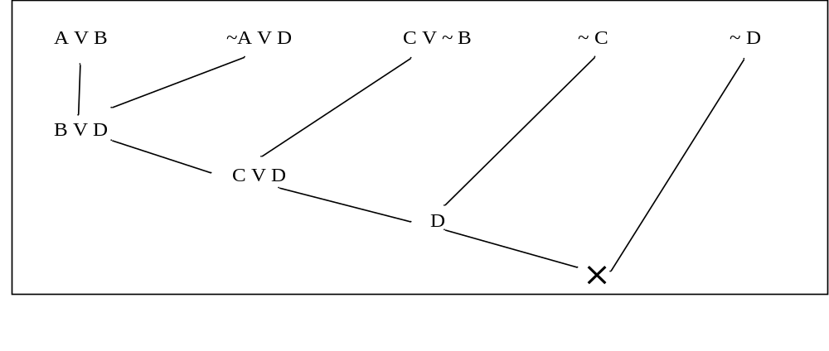
Example
Show that C V D is a logical consequence of
  S ={AVB, ~ AVD, C V~ B} using resolution refutation principle.
First we will add negation of logical consequence
  i.e., ~ (C V D) ≅ ~C Λ ~D to the set S.
  Get S’ = {A V B, ~ A V D, C V~ B, ~C, ~D}.
Now show that S’ is unsatisfiable by deriving contradiction using resolution principle.

Slide 24
Example
Example: “Mary will get her degree if she registers as a student and pass her exam. She has registered herself as a student. She has passed her exam”. Show that she will get a degree.
Solution: Symbolize above statements as follows:
      R : Mary is a registered student
      P : Mary has passed her exam
      D : Mary gets her degree
The formulae corresponding to above listed sentences are as follows:

Slide 25
Cont…
Mary will get her degree if she registers as a student and pass her exam.
R Λ P → D ≅ (~ R V ~ P V D)
She has registered herself as a student.
R
She has passed her exam.
P
Conclude “Mary will get a degree”.
D

Slide 26
Example – Cont…
Set of clauses are:
  S = {~ R V ~ P V D , R, P }
Add negation of "Mary gets her degree (= D)" to S.
New set S' is:
  S' = {~ R V ~ P V D , R, P, ~ D}
We can easily see that empty clause is deduced from above set.
Hence we can conclude that “Mary gets her degree”

Slide 27
Deriving Contradiction
~ R V ~ P V D R
~ P V D P
D ~ D

